Slide 1
Perfect Competition
Assumptions of the Perfectly Competitive Model Large number of sellers Homogeneous product No entry barriers Perfect information
Profit Maximization in the Short-run Produce where MC=MR If P>ATC, short-run economic profits can be earned
Profit Maximization in the Long-run Easy entry and exit assure firms will only earn normal profits in the long-run
The Shut-down Rule When a firm should shut down while earning losses If total losses are greater than a firm’s total fixed costs
Efficiency under Perfect Competition Allocative efficiency: Does the price equal the marginal cost? Productive efficiency: Do firms produce at their minimum ATC?

Slide 2
Costs of Production
Four Market Structures
Introduction to Market Structures
Product markets come in many forms. The four market structures are introduced below.
Characteristic | Pure (or Perfect) Competition | Monopolistic Competition | Oligopoly | Monopoly
Number of Firms | VERY large number of firms | Fairly large number of firms | A few large firms dominate an industry | Only ONE firm. The firm IS the industry
Price making abilities of individual firms | Each firm is so small that changes in its own output do not affect market price, i.e. firms are price takers | Firms are small relative to the industry, meaning changes in one firms output have only a slight impact on market price | A change in one firm's output has significant impact on the market price, firms are price-makers. | Changes in the firm's output cause changes in the price, i.e. the firm is a price-maker!
Type of product | Firms all produce identical products, with no differentiation | Products are slightly differentiated. Firms will advertise to try and further differentiate product. Branding! Advertising! | Products can be identical (such as oil) or differentiated (such as Macs and Dells) Firms will likely use advertising to try and differentiate their products from competitors' | Unique product, no other firm makes anything like it.
Entry barriers | Completely free entry and exit from the industry, i.e. NO barriers to entry. | Limited barriers to entry, firms can enter or leave easily | There are significant barriers to entry | Significant barriers to entry exist, preventing new firms from entering and competing with the monopolist

Slide 3
Costs of Production
Assumptions of Perfect Competition
Assumptions of the Perfectly Competitive Market Model
To begin our studies of competition in different markets, we will examine the perfectly competitive market model.
A perfectly competitive market is one in which:
There is a very large number of firms,
Selling identical products to one another,
In which there are no barriers to entry or exit
And in which individual firms have no control over the market price.
Example: Imagine you live in New York City and want to have a cheese pizza for lunch. Let’s assume…
There are hundreds of pizza shops in New York
Every one of them has cheese pizza on their menu
They all pay their workers minimum wage. They all buy cheese, dough and tomato sauce at the same prices
It is cheap and easy to open a pizza shop, just as it is to shut one down if needed.
Based on these characteristics, the market for cheese pizzas in New York is close to perfectly competitive. You will pay the same price no matter where you order your pizza from!

Slide 4
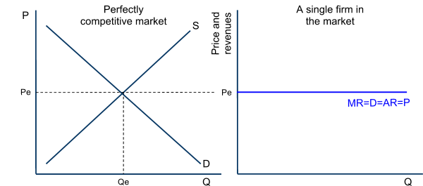
Costs of Production
Assumptions of Perfect Competition
Perfectly Competitive Firms are “Price Takers”
An individual firm in a perfectly competitive market has no control over the price of its own output. This is because the price is determined based on market supply and market demand.
Note from the graph below that:
The demand seen by the firm is determined by the price in the market.
Price also determines the firm’s marginal revenue
The firm has no “price-making power” because if it raises its price, it will sell no output, and
if it lowers its price, it will not be able to cover its costs of production.
Demand for the individual firm’s output is perfectly elastic
To maximize its profits, a firm should produce where its marginal revenue equals its marginal costs.

Slide 5
Quantity | Price – per unit | Total revenue | Average revenue | Marginal revenue
1 | 10 | 10 | 10 | -
2 | 10 | 20 | 10 | 10
3 | 10 | 30 | 10 | 10
4 | 10 | 40 | 10 | 10
5 | 10 | 50 | 10 | 10
6 | 10 | 60 | 10 | 10

Slide 6
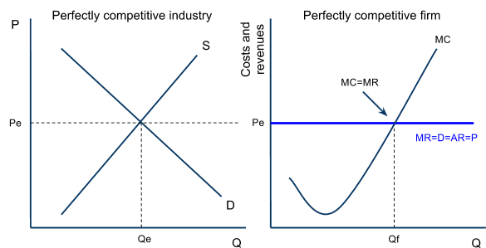
Costs of Production
Profit Maximization in the Short-run
Profit Maximization for the Perfect Competitor
In our previous unit we learned that, to maximize its economic profits at any given time, a firm should produce at the quantity at which its marginal revenue (MR) equals its marginal cost (MC)
In the graph below:
The firm is facing a marginal revenue equal to Pe, determined by the market price at any given time.
The firm’s marginal cost increases steadily due to diminishing returns (to make more pizzas in the short-run, more cooks must be hired, but because capital is fixed the marginal product of cooks decreases as more are added)
Based on its MC and MR, the firm will maximize its profits (or minimize its losses) by producing at Qf

Slide 7
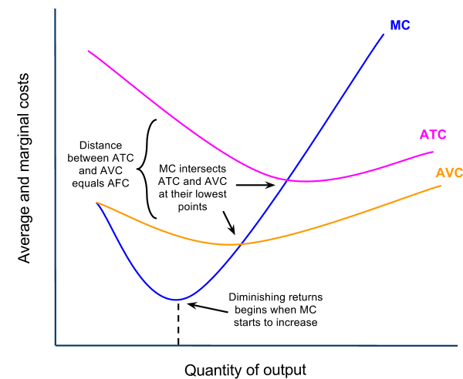
Costs of Production
Profit Maximization in the Short-run
Determining Short-run Economic Profits or Loss
A firm will maximize its profits (or minimize its losses) by producing at the quantity where MR=MC. To determine whether a firm is actually earning profits, breaking even, or earning losses at this quantity, we must consider both the firm’s average revenue (the price) and its average total cost.
Short-run Costs of Production: Recall from our earlier unit that a firm faces the following short-run production costs:
Marginal Cost, which slopes upwards because of diminishing marginal returns
Average variable cost, which is the per unit labor costs of production
Average total cost, which is the average variable costs plus the average fixed costs (the per-unit costs of fixed capital resources)
Recall also that MC must intersect the average cost curves at their lowest points.

Slide 8
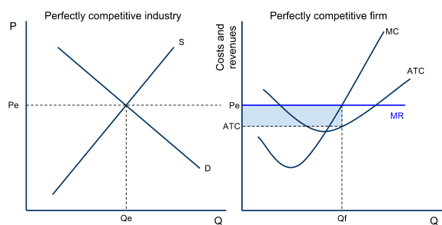
Costs of Production
Profit Maximization in the Short-run
Profit Maximization in the Short-run: The Profit-earning Firm
If, when producing at its MC=MR point, a firm in a perfectly competitive market is selling its output for a price that is greater than its average total cost, then the firm is earning economic profits. Economic profits mean the firm is covering all of its explicit and implicit costs, and is earning additional revenue beyond these as well.
Study the graph, and note:
The market demand is relatively high, presenting firms with a price that is greater than their ATC
The firm’s economic profits is the blue area (P-ATC)xQ.
The firm is maximizing its profits by producing where MR=MC.
Due to the absence of entry barriers, these profits will not be sustained in the long-run, as new firms will enter the market.

Slide 9
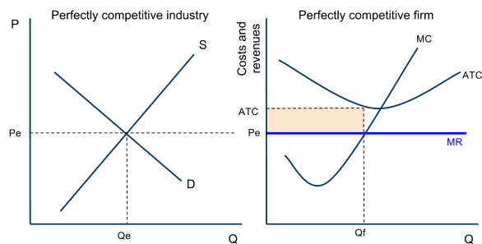
Costs of Production
Profit Maximization in the Short-run
Profit Maximization in the Short-run: The Loss-minimizing Firm
If, when producing at its MC=MR point, a firm in a perfectly competitive market is selling at a price that is lower than its average total cost, the firm will be minimizing its losses, but earning no economic profit at all. The loss minimizing firm will either exit the industry in the long-run, or hope other firms exit until the supply decreases, causing the price to rise once again.
Study the graph, and note:
The market demand is relatively low, so the price the firm can sell its output for is below its average total cost
The firm’s economic losses are the yellow area (ATC-P)xQ.
The firm is minimizing its losses by producing where MR=MC.
Due to the absence of entry barriers, these losses will be eliminated in the long-run as firms exit the industry to avoid further losses.

Slide 10
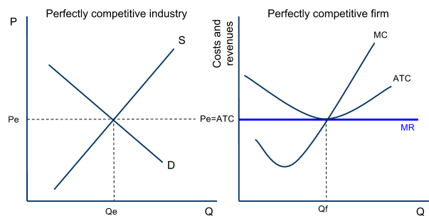
Costs of Production
Profit Maximization in the Short-run
Profit Maximization in the Short-run: The Breaking-even Firm
If, when producing at its MC=MR level of output, the price the firm can sell its output for is exactly equal to the firm’s minimum average total cost, then the best the firm can hope to do is to break even. Breaking even means a firm is covering all of its explicit and implicit costs, but earning no additional profit. The firm is earning only a NORMAL PROFIT.
Study the graph, and note:
The market demand and supply have set a price equal to the firm’s minimum average total cost.
The firm is just covering all its costs, meaning it is earning zero economic profits, but no losses
If the firm produced at any quantity other than Qf, it would earn economic losses. By producing at Qf, it is breaking even.
There is no incentive for firms to enter or exit this market.

Slide 11
Costs of Production
Profit Maximization in the Long-run
Profit Maximization in the Long-run
Recall from an earlier unit that the long-run is defined as:
The period of time over which firms can adjust their plant size in response to changes in the level of demand for their product. New firms can enter a market and existing firms can exit a market in the long-run. The long-run is the variable-plant period.
Entry and exit in the long-run: In perfectly competitive markets, firms can enter or exit the market in the long-run.
If economic profits are being earned, firms will be attracted to the profits and will want to enter the market
If economic losses are being earned, some firms will wish to minimize their losses by shutting down and leaving the market
Due to the entry and exit of firms in perfectly competitive markets, economic profits and losses will be eliminated in the long-run and firms will only BREAK EVEN.
When all the firms in a perfectly competitive market are breaking even, a market is in its long-run equilibrium state. No firms will with to enter OR exit a market in which firms are breaking even!

Slide 12
Costs of Production
Profit Maximization in the Long-run
Long-run Equilibrium in Perfect Competition
A perfectly competitive market is in its long-run equilibrium ONLY when the typical firm is breaking even.
Equilibrium is defined as “a state of balance”
If any profits or losses are being earned, a PC market is out of balance, and firms will enter or exit the market until equilibrium is restored.

Slide 13
Costs of Production
Efficiency
Efficiency in Perfectly Competitive Markets
In long-run equilibrium, purely competitive firms will produce the efficient level of output and price. Efficiency in economics is measured in two ways: Firms can be productively efficient and an industry can be allocatively efficient.
Productive Efficiency is achieve if firms produce at their minimum average total cost:
Interpretation: Firms are using resources to their maximum efficiency by producing their output at the lowest possible average total cost. Competition forces firms to use resources as efficiently as possible.
Allocative Efficiency is achieved if a market produces at the quantity where marginal benefit equals marginal cost (where Price = Marginal Cost)
Interpretation: The right amount of output is being produced. There is neither under nor over-allocation of resources towards a good in a purely competitive industry.
If the price were higher than the marginal cost, this is a signal that marginal benefit exceeds marginal cost and more output is desired,
If price were lower than marginal cost, the signal from buyers to sellers is that marginal cost exceeds marginal benefit and less output is desired.
Only when P = MC is the right amount of output being produced.

Slide 14
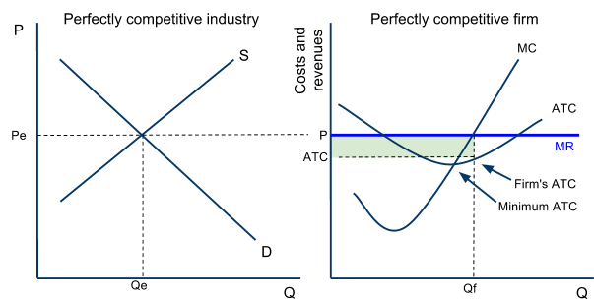
Costs of Production
Efficiency
Efficiency in Perfectly Competitive Markets – Productive Efficiency
Price acts as a signal in competitive markets of the demands (and therefore the marginal benefit) of consumers. Price will always equal firms’ minimum ATC in the long-run, assuring that perfectly competitive sellers will be productively efficient.
If price is high enough that firms are earning profits, then the signal from buyers to sellers is WE WANT MORE
If price is low enough that firms are earning losses, then the signal from buyers to sellers is WE WANT LESS
Consider the market and firm here:
Price is higher than the firm’s ATC.
The firm’s are earning economic profits
The signal from buyers is “we want more”, so more firms will enter the market to satisfy demand.
As new firms enter, price will fall to minimum ATC, and firms will be more productively efficient!

Slide 15
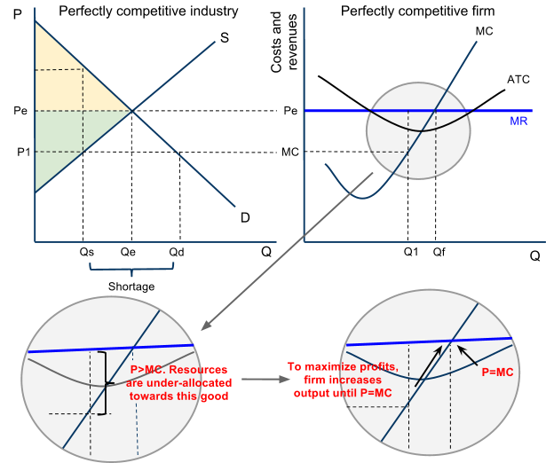
Costs of Production
Efficiency
Efficiency in Perfectly Competitive Markets – Allocative Efficiency
Study the graphs here:
Assume the firm (which represents all firms in this market) produces at Q1.
Market quantity supplied will be only Qs. At Qs, the demand (MB) is greater than the supply (MC) of the good. Resources are under-allocated.
The profit-maximizing firm will increase its production to Qf to achieve the MR=MC point.
As all firms do so, market quantity increases to Qe.
When all firms produce where P=MC, the shortage that existed at Qs is eliminated and resources are efficiently allocated toward this good!

